Slide 1
Introduction to Node.js
Tekla Aivazashvili

Slide 2
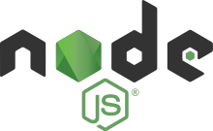

Node.js is an open-source, Server Side, JavaScript runtime environment that executes JavaScript code outside a web browser. Node.js represents a "JavaScript everywhere" paradigm, unifying web-application development around a single programming language, rather than different languages for server- and client-side scripts.
Node.js is best suited for real-time applications: online games, collaboration tools, chat rooms, or anything where what one user does with the application needs to be seen by other users immediately, without a page refresh.
Asynchronous and Event Driven – many connections can be handled at once
Ryan Dahl, creator of Node.js, in 2009

Slide 3
Here is how PHP or ASP handles a file request:
Sends the task to the computer's file system.
Waits while the file system opens and reads the file.
Returns the content to the client.
Ready to handle the next request.
Here is how Node.js handles a file request:
Sends the task to the computer's file system.
Ready to handle the next request.
When the file system has opened and read the file, the server returns the content to the client.
Node.js eliminates the waiting, and simply continues with the next request.
Node.js runs single-threaded, non-blocking, asynchronously programming, which is very memory efficient.

Slide 4
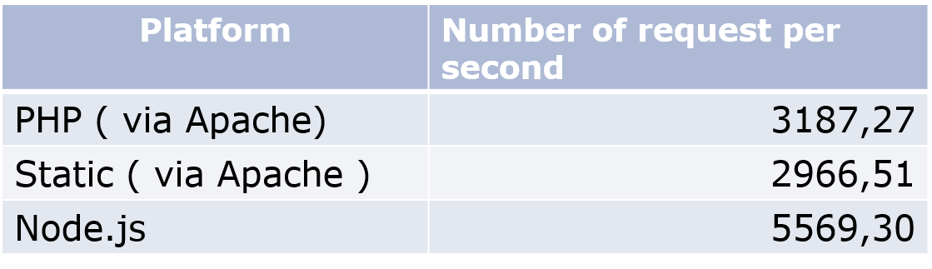
Node.js VS Apache
It's fast
It can handle tons of concurrent requests
It's written in JavaScript (which means you can use the same code server side and client side)

Slide 5
What is unique about Node.js?
JavaScript used in client-side but node.js puts the JavaScript on server-side thus making communication between client and server will happen in same language
Servers are normally thread based but Node.JS is “Event” based. Node.JS serves each request in a Evented loop that can able to handle simultaneous requests.
What Can Node.js Do?
Node.js can generate dynamic page content
Node.js can create, open, read, write, delete, and close files on the server
Node.js can collect form data
Node.js can add, delete, modify data in your database

Slide 6
Reasons to use Node.JS:
The single-threaded event-driven system is fast even when handling lots of requests at once, and also simple, compared to traditional multi-threaded Java or ROR frameworks.
In a normal process cycle the webserver while processing the request will have to wait for the IO operations and thus blocking the next request to be processed. Node.JS process each request as events, The server doesn’t wait for the IO operation to complete while it can handle other request at the same time. When the IO operation of first request is completed it will call-back the server to complete the request.
What can’t do with Node?
Node can’t run on GUI, but run on terminal

Slide 7
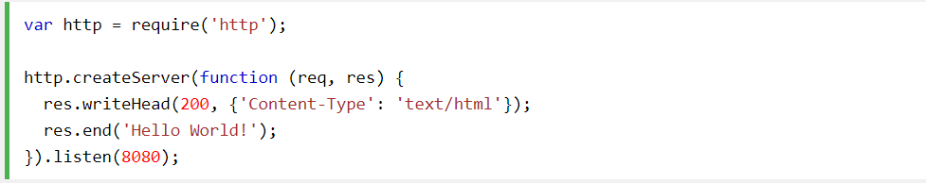
First program
built-in module called HTTP, which allows Node.js to transfer data over the Hyper Text Transfer Protocol (HTTP).

